Slide 1



Social Buzz

Slide 2


Today's agenda
Project recap
Problem
The Analytics team
Process
Insights
Summary

Slide 3

Project Recap
Social Buzz tasks:
An audit of Social Buzz’s big data practice.
Recommendation for successful IPO.
Find top 5 content categories through data analysis.

Slide 4

Problem
Social Buzz has:
Over 100000 posts per day.
36,500,000 content every year.
Handling Big Data.

Slide 5



Andrew Fleming
Chief Technology Architect
The Analytics team
Marcus Rompton
Senior Principal
Nitesh Addagatla
Data Analyst

Slide 6
Process
1
Problem Understanding
2
Data Collection and Cleaning
3
Data Modelling
4
Data Analysis
5
Data Visualization

Slide 7
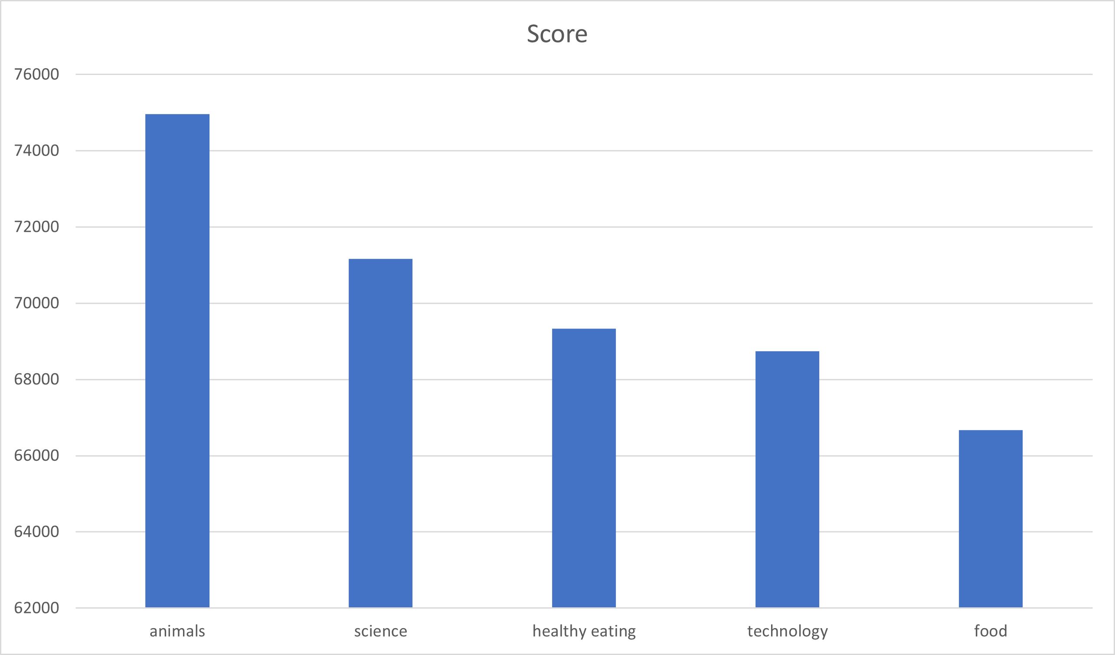

Top 5 Categories
Insights

Slide 8
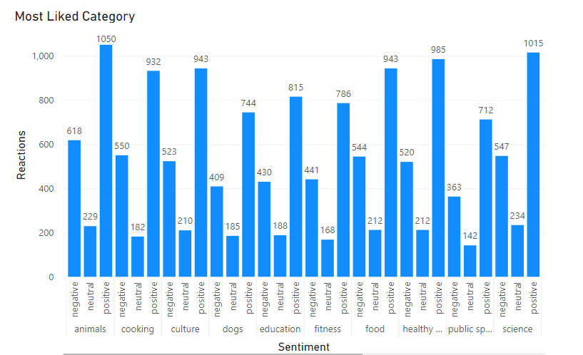
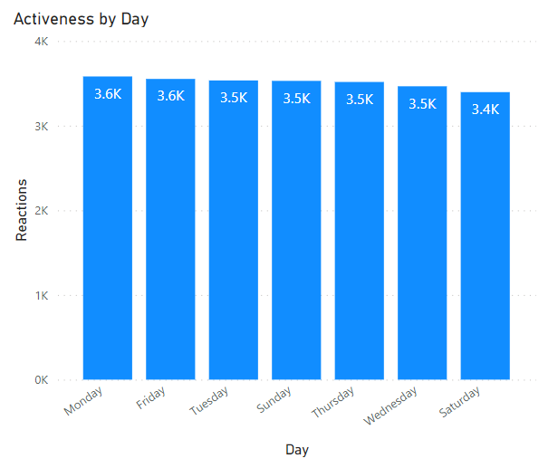

Slide 9
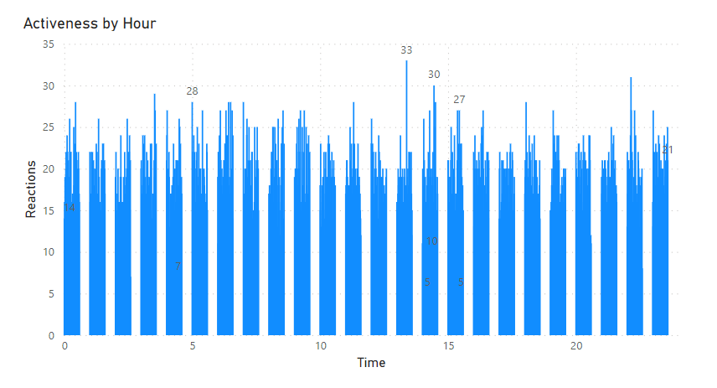
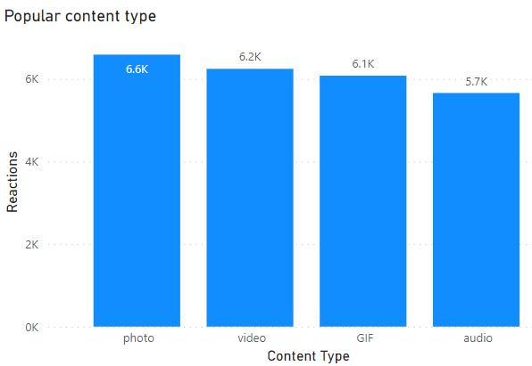

Slide 10

Top 5 Categories:
Animals (1897 Reactions)
Science
Healthy Eating
Technology
Food
There is a slight decline in content uploading in the year 2021 compared the year 2020
Most active days:
Monday
Tuesday
Friday
Least Active day:
Saturday
There are total 16 unique categories.
Summary
Most Liked Category:
Animals
Most Disliked:
Science
Popular Content Type:
Photos
Videos
Most Active Time:
01:00 PM
02:00 PM
03:00 PM

Slide 11
Thank you!
ANY QUESTIONS?

